Slide 1


Instructor-XL and LLM powered Recommendation System
By Kunal Tyagi

Slide 2
> We found that 57% of people were NOT confident
in wanting to spend money on vacation[1]
Market Research
We took some liberty and performed a market research and survey.
> This left a large gap that can be covered by solving the problems that are creating the said gap!
> We then decided to do a survey to find out what these problems were.
>
>
Let us look at the result of the survey.
1. https://www.allianztravelinsurance.com/travel/vacation-confidence index/2022-vacation-confidence-index-summer-travel-trends-revealed.htm

Slide 3
Do you avoid traveling due to the time and stress involved in vacation planning?
Results of the Survey
We took some liberty and performed a market research and survey.
Do you avoid traveling because you don’t want to spend money?
Grouped by Yes in Q1

Slide 4


Inferences from the Survey
From the survey we inferred that creating a personalised conversational recommendation engine holds significant potential of increasing the sales of the company, especially in the untapped markets.
We will develop this solution using the state of the art LLMs
and Specialised embedding models.
This solution will have a low initial capital expenditure and operating expenditure compared to hiring and setting up a customer sales relationship executive team.
From the data of the survey we drew a few inferences that helped us shape our problem statement.

Slide 5

Instructor-XL
OpenAI - GPT 3.5 Turbo Google- flan t5 xxl LangChain
StreamLit (Prototyping)
FAISS
Solution Stack

Slide 6
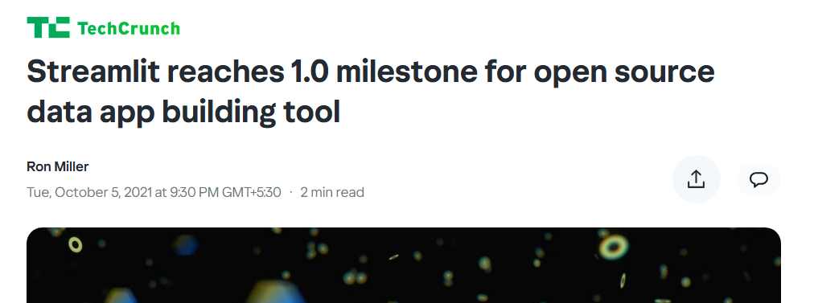
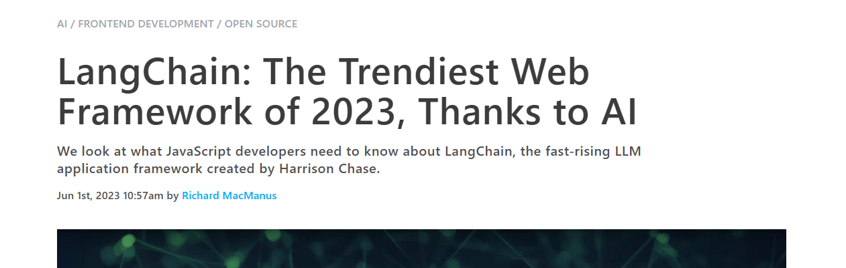
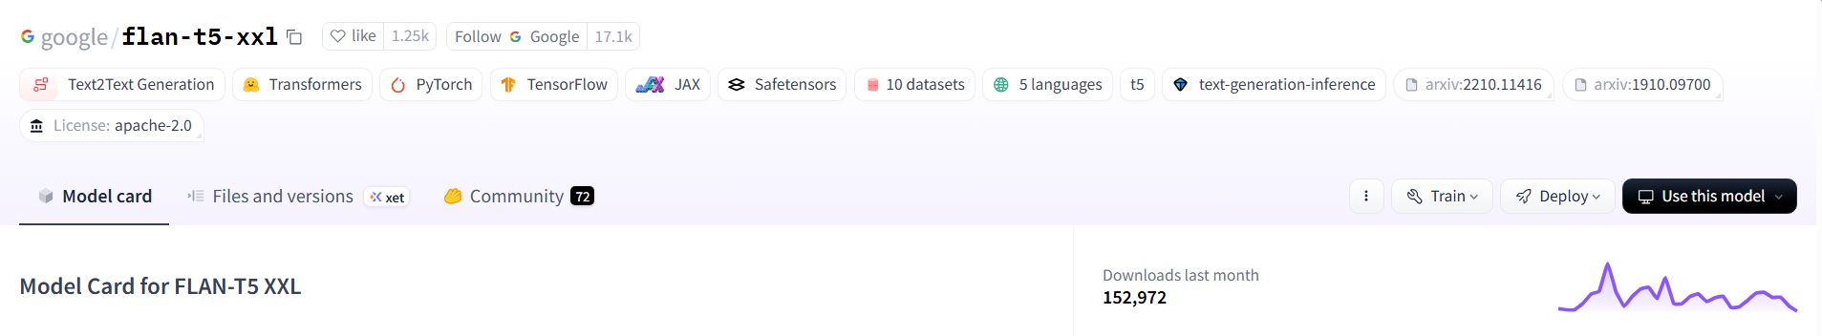
Why? Because They're The Best.

